Slide 1
To upgrade or not to Third Wave Coffee
Coursera Capstone Project

Slide 2
Introduction

Slide 3
Problem
As third-wave of coffee is gathering steam all around the world and new ventures in Bengaluru are starting to offer it, which coffee shops in Kengeri (an area in Bengaluru) should or shouldn’t upgrade to offer third wave coffee?
Investors, knowing the Third Wave Coffee revolution in US and its potential in Bengaluru would be curious to know which ones to invest in.

Slide 4
Data Acquisition and Cleaning
Third Wave Coffee Shops in US data was scraped from the food for net website.
INon Third Wave Coffee Shops in US data was scraped from Yelp.
Details of the venues were obtained using FourSquare API
Instances in which details were incomplete were dropped from the dataset.

Slide 5
Findings

Slide 6
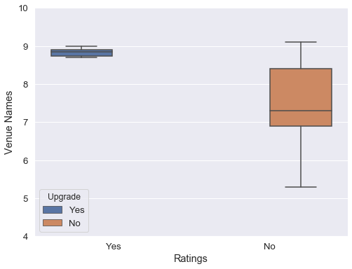
Relationship between Ratings and Upgrade feature
Coffee Shops with high ratings are most likely to be serving third-wave coffee when compared to ones which do not serve third-wave coffee.
I

Slide 7
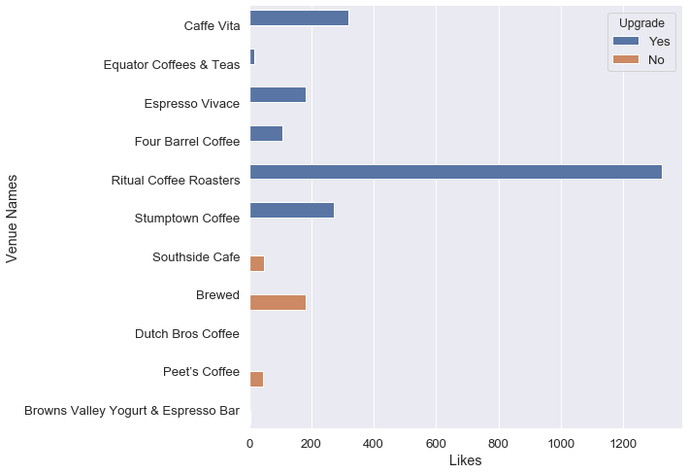
Relationship between Likes and Upgrade feature
Coffee Shops with huge number of Likes are most likely to be serving third-wave coffee when compared to ones which do not serve third-wave coffee.
I

Slide 8
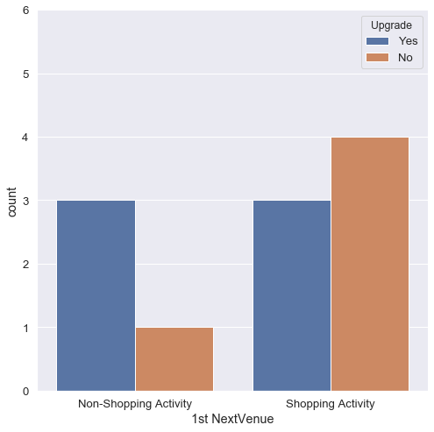
Relationship between 1st NextVenue and Upgrade feature
If the most visited venue after coffee is a Shopping activity then it’s mostly likely to be done after having coffee from a Non Third-wave coffee shop.
I

Slide 9
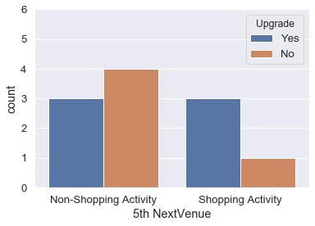
Relationship between 5th NextVenue and Upgrade feature
If the fifth most visited venue after coffee is a Non-Shopping activity then it’s mostly likely to be done after having coffee from a Non Third-wave coffee shop.
I

Slide 10
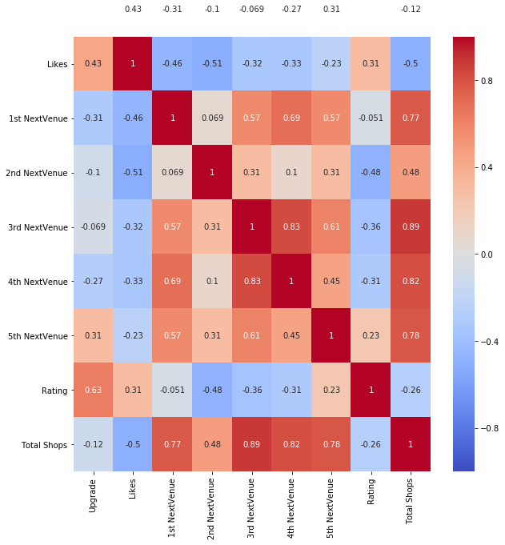
Correlation Heatmap
Based on above observations, following independent variables are to be taken into consideration for predicting dependent variable "Upgrade".
• Likes
• Rating
• 1st NextVenue
• 5th NextVenue
I

Slide 11
63%
Rating’s correlation with Upgrade Feature

Slide 12
Result

Slide 13
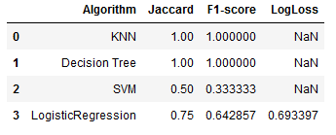
Decision Tree is the best Algorithm
Can return similar numbers when large testsets are given unlike KNN, which wouldn't be able to do if the instances aren't similar to each other.

Slide 14
The top five venues visited after having a coffee is a important feature.

Slide 15
Conclusion
Although certain models shows a 100% accuracy, the training dataset doesn’t have as many instances as required than required but the above observations are relevant and can be backed even better using larger datasets. It would also increase the relevance of the top five NextVenues relationship with target feature.
More features like user check-ins could help in making models more effective as it could present different scenarios which, at the end of the day is important to generate trustworthy results and in general understand the Third-wave coffee scene in USA.
I

Slide 16
“Life is opinion”
- Marcus Aurelius

Slide 17

Thanks!

